Slide 1


Department of Artificial Intelligence and Data Science
smart fitness:personalized workout recommendation web application using decision tree algorithm
Dr.J.Manoranjini
Associate professor
MADHUMITHA.G 221801030

Slide 2
Problem Statement and Motivation
PROBLEM STATEMENT
A fitness web app wants to personalize workout recommendations by analysing user fitness goals and workout performance data. They aim to improve users engagement and fitness outcomes.
MOTIVATION:
A personalized fitness app boosts engagement and effectiveness by tailoring workouts to individual goals, making fitness enjoyable and accessible. This targeted approach enhances user satisfaction and long-term commitment.

Slide 3
Objectives
Creating a dynamic workout recommendation engine that generates tailored workout plans based on user profiles and performance data
Developing a comprehensive user profiling system that captures individual characteristics, fitness levels, and goals

Slide 4
Abstract
In our Project we investigate the fitness app's strategy to personalize workout recommendations by analyzing user fitness goals and performance data. The aim is to enhance user engagement and improve fitness outcomes effectively. By leveraging advanced data analysis techniques, the app tailors workout regimens to individual needs, thereby optimizing the user experience. The effectiveness of this personalized approach is evaluated through metrics that assess both engagement levels and fitness progress. This research undergoes with decesion tree algorithm to personalize fitness apps in fostering healthier lifestyles.

Slide 5
Introduction and Overview of the Project.
Fitness apps have revolutionized the way individuals approach their health and wellness goals.
However, maintaining user motivation and adherence to recommended workouts remains a significant challenge.
This project aims to address these issues by enhancing fitness apps with advanced features designed to boost engagement and commitment.
fitness apps can incorporate gamification elements, such as rewards and challenges, to make workouts more engaging.
They can also provide personalized reminders and progress tracking to keep users motivated.

Slide 6
Literature Survey
S.No | Author Name | Paper Title | Description | Jornal | Volume/ Year
01. | S. Sadhasivam, M. S. Sarvesvaran, P. Prasanth and L. Latha | , "Diet and Workout Recommendation Using 5ML" | S. Sadhasivam et al. (2023) propose a machine learning-based system for personalized diet and workout recommendations. | 2023 2nd, International Conference on Advancements in Electrical Electronics Communication Computing and Automation (ICAECA) | 2023
02. | .Deepanjali Chowdhury, Ahana Roy, Sreenivasan Ramasamy Ramamurthy and Nirmalya Roy | "CHARLIE: A Chatbot That Recommends Daily Fitness and Diet Plans". | chatbot that recommends personalized daily fitness and diet plans, using AI to promote user health via conversational interactions and real-time guidance. | IEEE, International Conference on Pervasive Computing and Communications Workshops, | 2023

Slide 7
S.No | Author Name | Paper Title | Description | Jornal | Volume/ Year
03. | Divay Mogaverr and Vedant Mathu, | "E- health Monitoring System with Diet and fitness Recommendation using machine Learning", | Divay Mogaverr and Vedant Mathu (2022) propose an AI-based e-health system for personalized diet and fitness recommendations. | 6th international on inventive computation (ICICT), | 2022
04. | Gourangi Taware, Rohit Agrawal, Pratik Dhende, Prathamesh Jondhalekar and Shailesh Hule, and | AI-based Workout Assistant and Fitness guide" | Gourangi Taware et al. (2021) present an AI-based assistant for personalized fitness plans using machine learning. | IJERT | vol. 10, no. 11, November 2021.
05. | .Hung-Kai Chen, Fueng-Ho Chen and Shien-Fong Lin | "An AI-Based Exercise Prescription Recommendation System" | Hung-Kai Chen et al. (2021) present an AI system for personalized workout recommendations based on user health data. | Applied Science | pp11,2022

Slide 8
Existing Sytem
1. MyFitnessPal: Tracks diet and exercise, offering personalized
recommendations based on user goals. It provides detailed nutrition information and integrates with various fitness devices.
2. Nike Training Club: The app personalizes workout recommendations based on user preferences, fitness level, and goals. It suggests specific workouts and programs to help users achieve their desired outcomes.
3. Strava:Focuses on running and cycling, allowing users to track performance, set goals, and compete with others in the community.

Slide 9
Drawback of Existing System
1.Motivation and Adherence: Difficulty in maintaining user’s motivation and adherence to recommended workouts can impact effectiveness.
2.Limited Integration: Lack of integration with other health data sources can restrict the accuracy of recommendations.
3.Data Privacy Concerns: Users may be hesitant to share personal health data due to privacy and security concerns.
4. Inaccurate Data Interpretation: Misinterpretation of user data can lead to ineffective or inappropriate workout recommendations.

Slide 10
Proposed System
Training the Model:
Input: Features from user data (e.g., fitness level, goals, workout history).
Output: Recommended workout plan (e.g., workout type, intensity, duration).
Training Process: Use historical data and supervised learning to train the decision tree to map user features to optimal workout recommendations.
Decision Nodes: Create decision nodes based on criteria like fitness goals, workout preferences, and user performance metrics.
Leaf Nodes: Each leaf node represents a personalized workout plan recommendation.

Slide 11
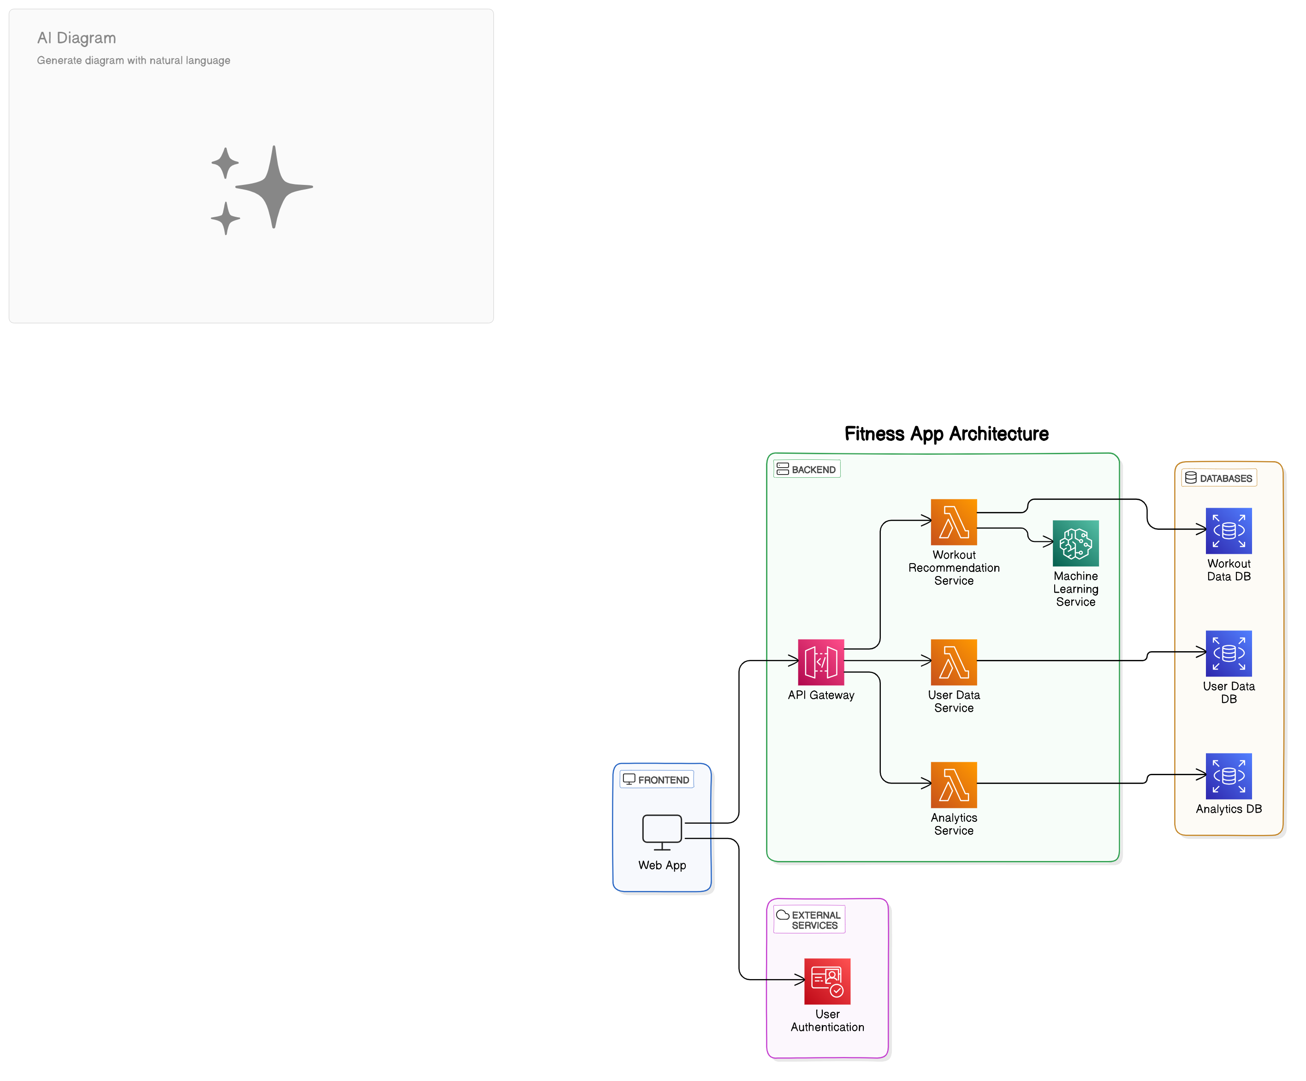
System Architecture

Slide 12
List of modules
Data collection
BMI calculation
Decision tree Training
Exercise recommendation using Content based filering algorithm
output

Slide 13
Admin module
secure login for admin to manage users and system data.
Admins can view user activity and perform system maintenance.
Includes authentication and access control for privileged users.
Technology: Flask authentication and session handling.

Slide 14
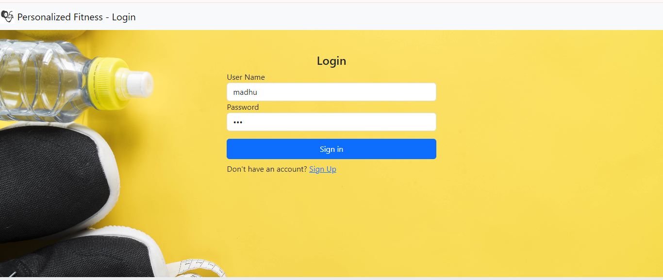
ADMIN LOGIN PAGE

Slide 15
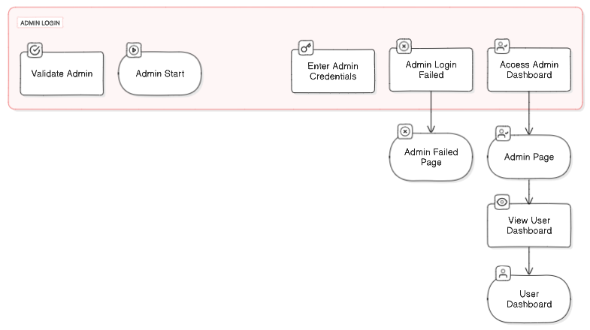
DFD for admin page

Slide 16
Admin tracking user Dashboard
Purpose:
To provide administrators with a comprehensive overview of user activity and engagement within the fitness app.
User Management:
Overview of Registered Users: Displays a list of all registered users with essential details (name, email, registration date).
User Status: Indicates whether users are active, inactive, or pending verification.
Activity Tracking:
User Activity Log: Monitors and records user actions (e.g., login frequency, workout sessions completed).
Engagement Metrics: Visual representations (charts/graphs) showing user engagement trends over time.

Slide 17
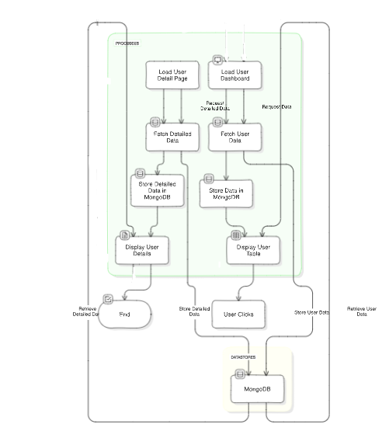
DFD for maintaining user data

Slide 18
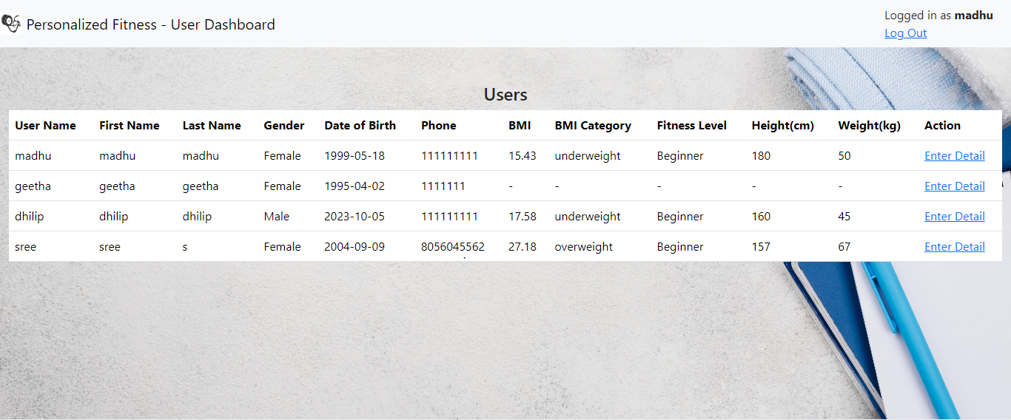
Admin tracking users dashboard module

Slide 19
User signup module (data collection)
New users can register by providing details like name, email, and fitness goals.
Form validation ensures correct data input.
User data is securely stored in the database (e.g., MongoDB).
Technology: API interaction with backend for user registration.

Slide 20
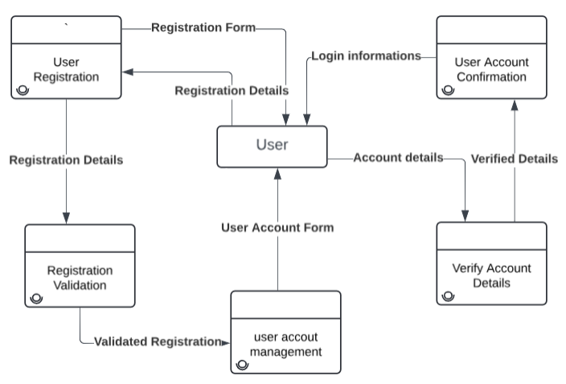
DFD for user signup page

Slide 21
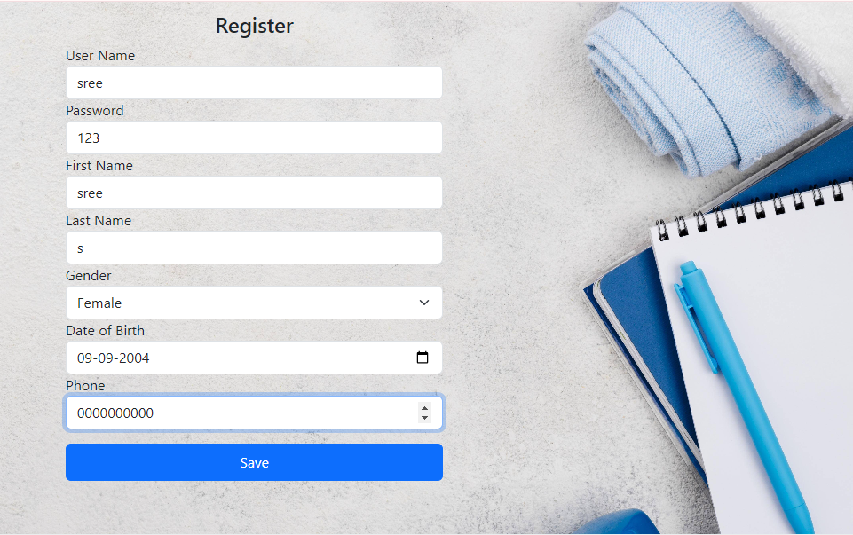
user signup page module

Slide 22
User Login Module:
Allows users to log in and access personalized features.
Authenticates user credentials and maintains secure sessions.
Error handling for incorrect credentials.
Technology: Flask session management and password hashing.

Slide 23
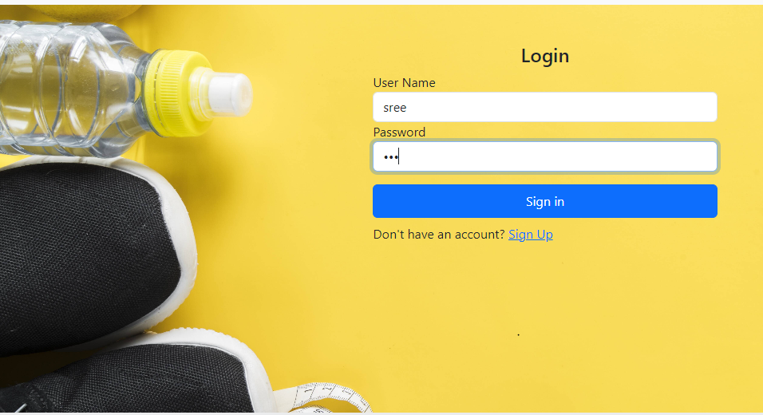
USER LOGIN PAGE module

Slide 24
Algorithm for BMI Calculation and Recommendation:
1. Input User Details :
- Prompt the user for their gender, age, height (in cm), and weight (in kg).
2. Calculate BMI :
BMI= Weight (kg)/ (Height (m))^2
Convert height from cm to meters by dividing by 100.
Provides customized workout plans based on BMI.
Technology: Basic arithmetic and decision tree for classification.

Slide 25
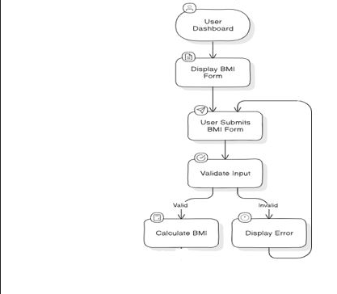
DFD of BMI calculation for user

Slide 26
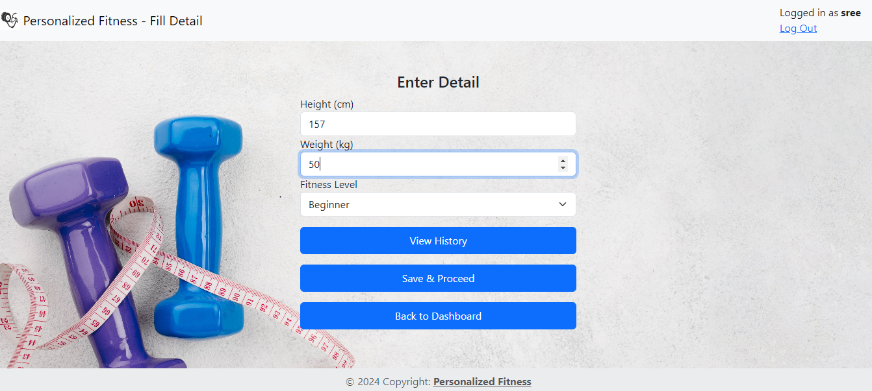
User Input for BMI

Slide 27
Decision Tree algorithm
Use Decision Tree as Classifier :
- Train a decision tree with sample data to classify BMI into one of four categories:
- 0 : Underweight
- 1 : Normal weight
- 2 : Overweight
- 3 : Obese
- Use the trained decision tree to predict the BMI category based on the user’s height and weight.

Slide 28
Content Based Filtering
Content-Based Filtering :
Based on the predicted BMI category, recommend specific exercises (e.g., sets and reps for squats, crunches, push-ups, pull-ups).
Output :
Provide personalized exercise recommendations and tips on whether to gain, maintain, or lose weight.
This algorithm ensures the user receives customized workout advice based on their BMI classification.

Slide 29
Workout Recommendation Engine:
Generates personalized workout plans based on user data.
Uses a decision tree algorithm to recommend exercises.
Continuously updates recommendations as user progress is tracked.
Technology: Machine learning and data analysis.

Slide 30
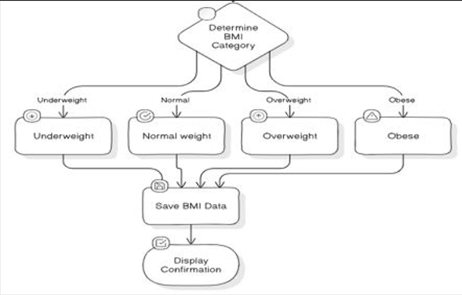
DFD for Workout recommendation engine

Slide 31
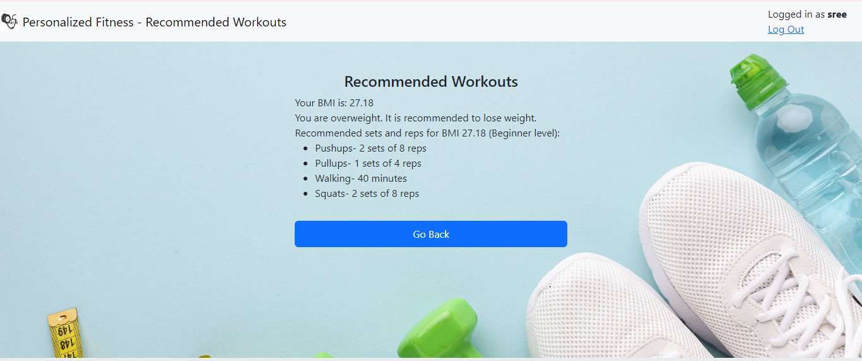
Workout Recommendation Output

Slide 32
User Profile and History Module:
Displays user data, fitness history, and workout progress.
Allows users to update personal details and goals.
Tracks workout sessions and their outcomes over time.
Technology: Database interaction for updating user profiles.

Slide 33
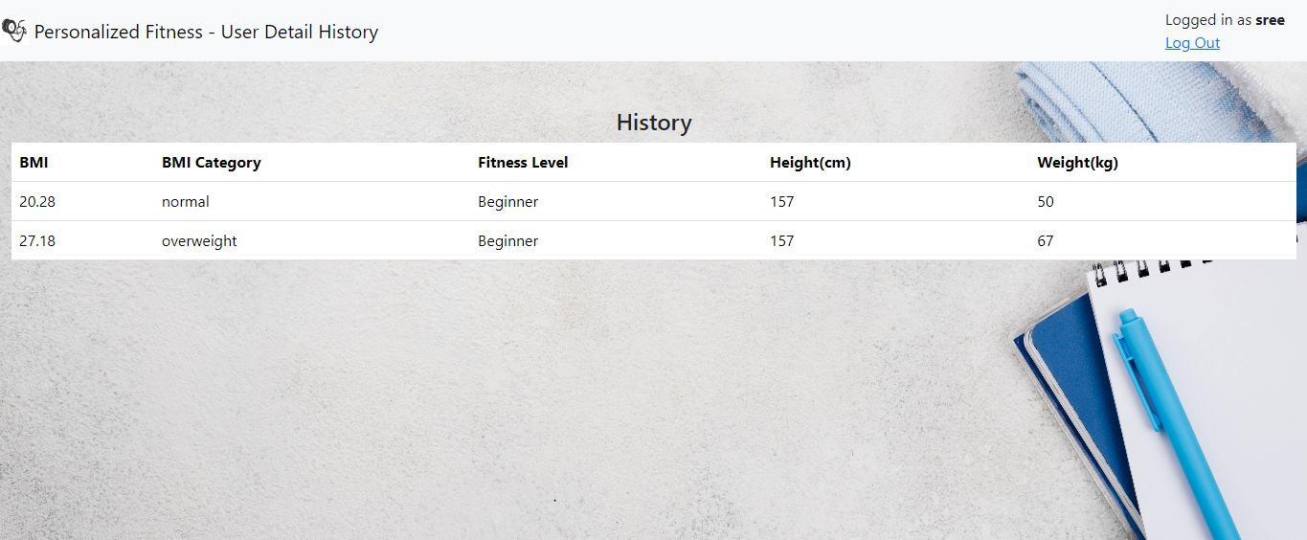
user history

Slide 34
Conclusion
The implementation of a deccision tree algorithm and content based filtering algorithm within our fitness web app enables highly personalized orkout recommendations tailored to each user’s unique fitness level, goals and preference .This approach ensures tailored, trasparent, and easily understandable workout plans. As the system learns from the user’s feedback, it adapts to provide even more refined recommendation, helping users achive their fitness goals more efficiently.

Slide 35
References.
1.Gourangi Taware, Rohit Agrawal, Pratik Dhende, Prathamesh Jondhalekar and Shailesh Hule, "2021 AI-based Workout Assistant and Fitness guide", (IJERT), vol. 10, no. 11, November 2021.
2.Hung-Kai Chen, Fueng-Ho Chen and Shien-Fong Lin, "An AI-Based Exercise Prescription Recommendation System", Applied Sciences, pp. 11, 2021.
3.Deepanjali Chowdhury, Ahana Roy, Sreenivasan Ramasamy Ramamurthy and Nirmalya Roy, "CHARLIE: A Chatbot That Recommends Daily Fitness and Diet Plans", IEEE International Conference on Pervasive Computing and Communications Workshops, 2023.
Divay Mogaverr and Vedant Mathu, "E- health Monitoring System with Diet and fitness Recommendation using machine Learning", 6th international on inventive computation (ICICT), 2022.
S. Sadhasivam, M. S. Sarvesvaran, P. Prasanth and L. Latha, "Diet and Workout Recommendation Using 5ML", 2023 2nd International Conference on Advancements in Electrical Electronics Communication Computing and Automation (ICAECA), 2023.

Slide 36
Thank You

